Slide 1
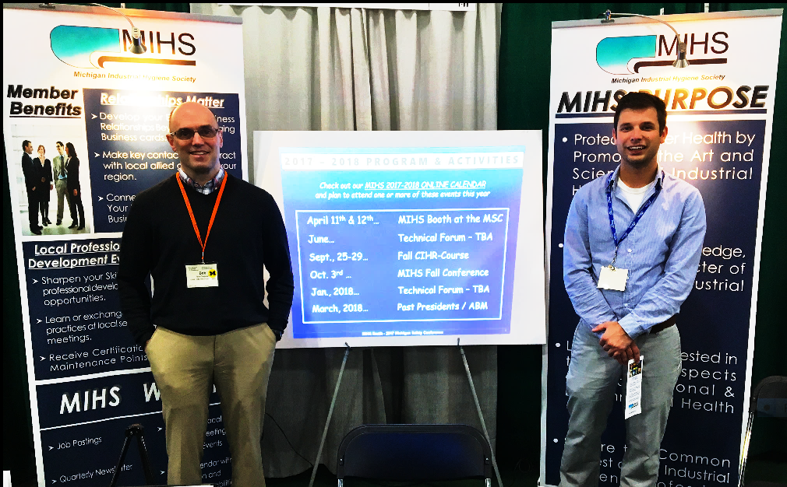
MIHS ACTIVITIES
Broadcast emails on the Latest News, Events, Meetings, and Job Postings.
Professional Development Courses that Provide Certification Maintenance Points.
Full-day Mini-Conference.
Past Presidents’ Breakfast and
Annual Business Meeting.
Student Award Night.
Co-sponsor CIH Review Course.
Present the James B. Darcy, Journal of Occupation and Environmental Health (JOEH) Paper Award.
Exhibit the MIHS Booth at the Michigan Safety Conference.
MIHS WEBSITE
mihsweb.org
Online Membership Directory
Post IH Job Opportunities.
Post Quarterly Newsletters.
Updates on Local IH Activities,
Meetings, News, and Events.
Online Event Calendar that has Registration and Credit Card
Payment Capability.
Membership Application
Name _______________________
Company _______________________
Address _______________________
City _______________________
State _____________ ZIP _________
Email __________________________
Phone __________________________
MEMBERSHIP OPTIONS: (check one)
____ FULL - $25 / year
___ ASSOCIATE - $25 / year
Any Person Having a Professional
Interest in Industrial Hygiene
___ STUDENT - $5 / year
Graduate or Undergraduate Student who is Enrolled in Occupational or Environmental Health Studies.
___ ORGANIZATION - $50 /year
The Organization is Listed on the MIHS Website and in the MIHS Newsletter.
Pay In Person or “Go To” mihsweb.org
and Click the “Join Now”
Link on Our Homepage.
PURPOSE STATEMENT
Protect Worker Health by Promoting the Art and Science of Industrial Hygiene
Advance the Knowledge, Skills, and Character of Professional Industrial Hygienists
Link People Interested in the Various Aspects of Occupational and Environmental Health & Safety
Secure the Common Interest of the Industrial Hygiene Profession
5
6
1

Slide 2

WHO WE ARE
ADVANTAGES OF MEMBERSHIP
Connect with Others Who Share Your Professional Interests and Business Concerns.
Develop your Existing Business Relationships Beyond Just Exchanging Business Cards.
Update Your Knowledge of Relevant Business and Technical Issues.
Get Certification Maintenance Points.
AMERICAN INDUSTRIAL
HYGIENE FOUNDATION (AIHF)
SCHOLARSHIP AWARDS
MIHS has Established Two Student Scholarship Awards through AIHF.
The MIHS Merit Scholarship
Award was established in 2006.
The Bill Cleary Memorial Scholarship
Award was established in 2021.
Learn More at…
aiha.org/foundations/AIHFoundation
ALREADY CERTIFIED?
MIHS Hosts Several Events per Year that Offer Certification Maintenance Points.
Obtain Your Certification Maintenance Points Locally and save on your Travel Budget.
Learn More about the Board for Global Certification (BGC) and the IH Certification Process at… gobgc.org/cih
SEEKING CERTIFICATION?
Two times a year The University of Michigan, Center for Occupational Health and Safety Engineering (UM-COHSE), and the MIHS Cosponsor an Online “Comprehensive Industrial Hygiene Review Course” (CIHR Course) that Prepares Attendees who are planning to take the CIH Exam.
As part of that effort, the MIHS also Provides an Annual Student Award that Pays the Recipient's Registration Fee to Attend the CIHR Course.
Attending MIHS-sponsored Events provides “Contact Hours,” which can be used to meet the IH coursework requirement for the CIH exam.
Founded in 1938, the Michigan Industrial Hygiene Society (MIHS) is a Local Section of our National Organization, the American Industrial Hygiene Association (AIHA), which was Founded in 1939.
MIHS members are Highly Trained Professionals Who Service the Occupational, Environmental, Health, and Safety Needs in their Communities.
Most Members are Industrial Hygienists Working for Corporations, Universities, Regulatory Agencies, Private Consulting Firms, and Companies that Service, Sell, and Distribute Occupational, Environmental, Health and Safety Products.
MIHS Welcomes All Individuals Interested in Occupational, Environmental, Health, and Safety to Join Our Organization.
Learn more about AIHA at aiha.org.
2
3

